Slide 1
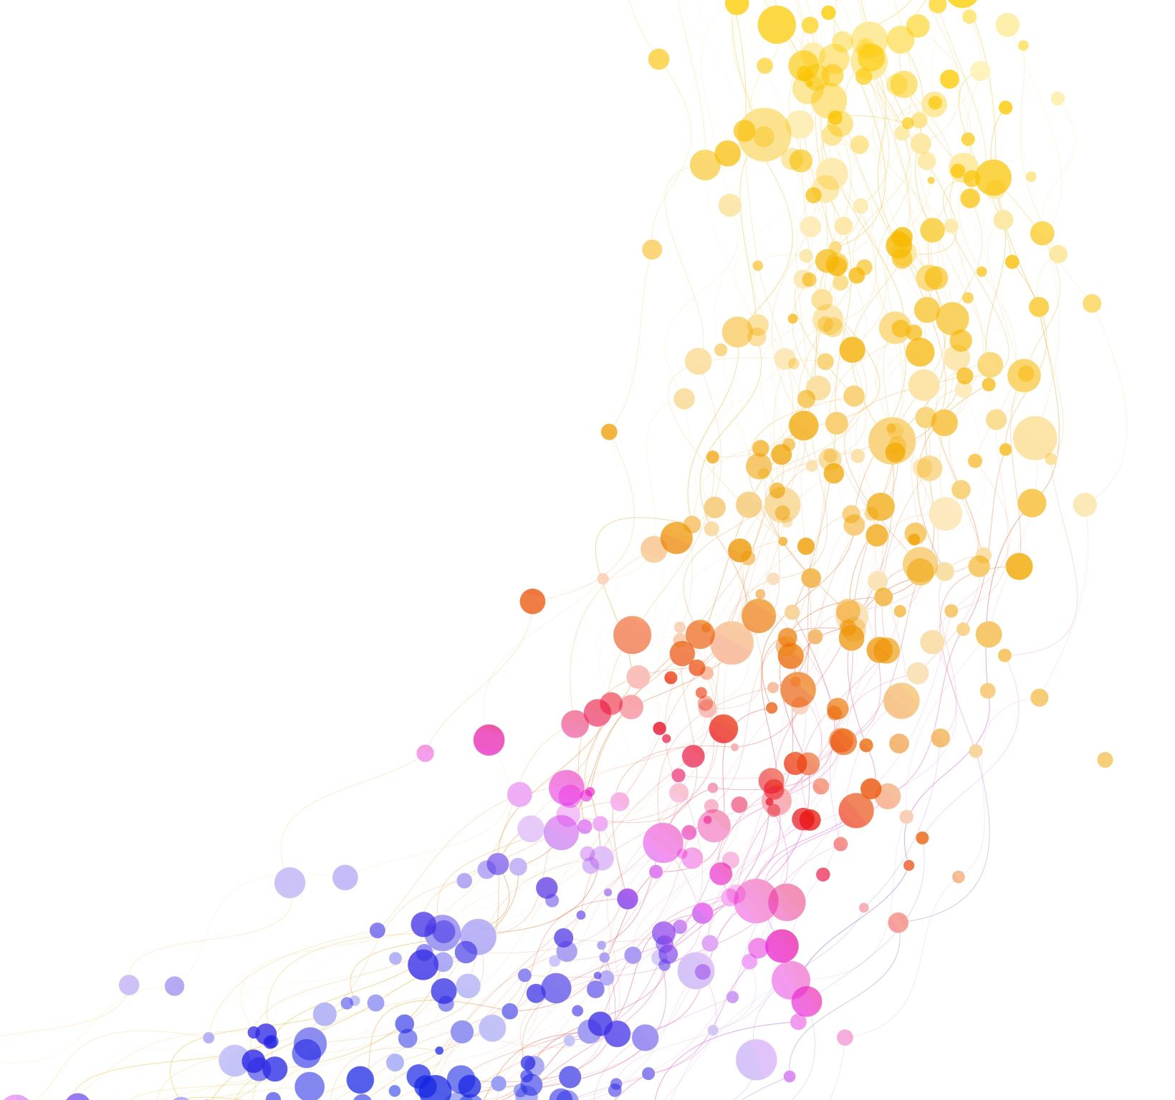
Benchmarking Modular Genetic Programming on Deep Memory Tasks
Mihyar Al Masalma

Slide 2
Road Map
What are we trying to achieve?
Tools and background.
Results
What’s next?
Q&A

Slide 3
What are you doing?
Different Instruction sets.
Different Noise.
Different task setup.

Slide 4
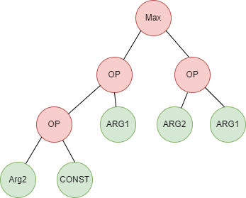
canonical GP?

Slide 5
Don’t know the whole story
What are partially observed tasks?
Why we care about it?
Where can we see it?

Slide 6
I need to remember
Why memory is important?
Internal vs external

Slide 7
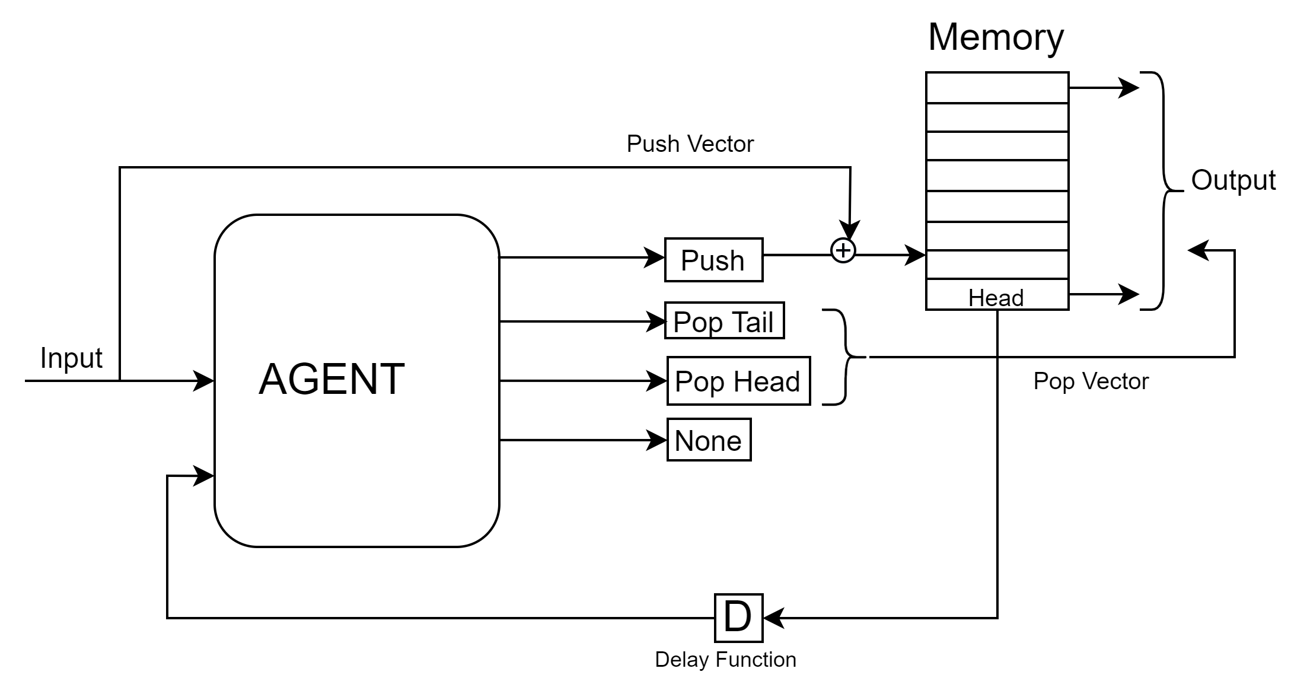
External memory interface

Slide 8
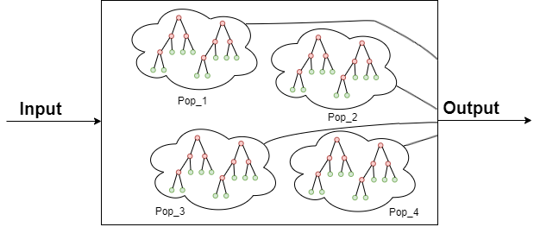
One output means One population
Limitation of canonical GP.
Work around and teams forming.

Slide 9
Deep memory tasks
Sequence Classification
Sequence Recall
Copy Task

Slide 10
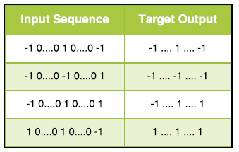
Sequence classification
Notes:
TODO: Add Task setup info

Slide 11
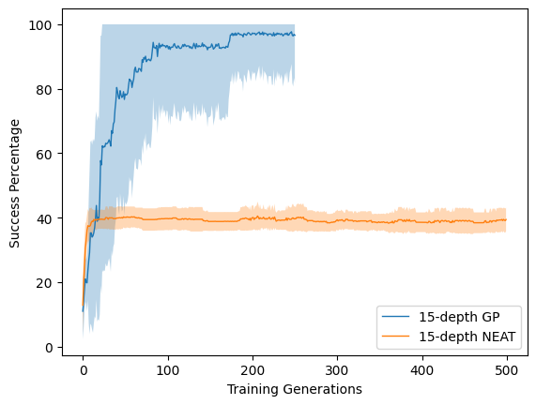
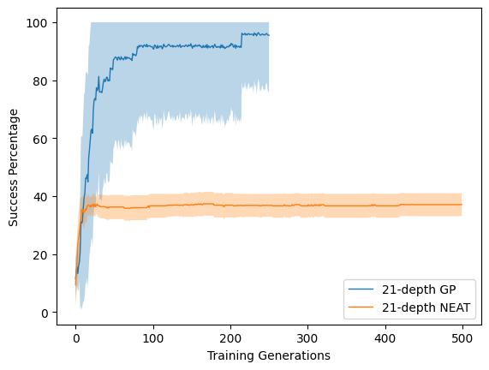
Genetic Programing vs Neural Network

Slide 12
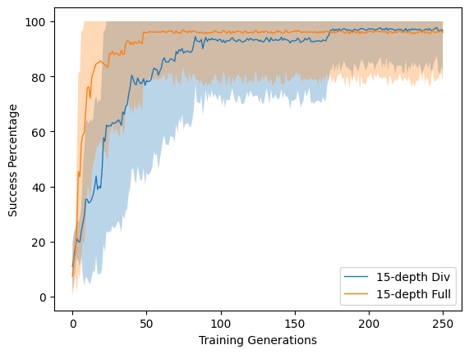
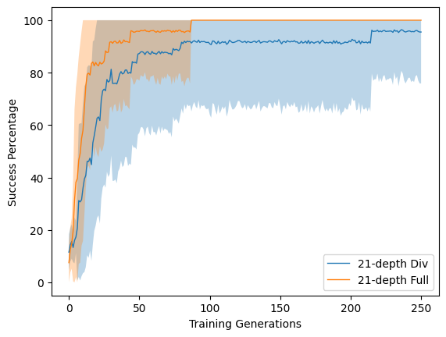
Division vs full instruction set
Notes:
Multiplication instruction set didn’t perform well, results were non-comparable.

Slide 13
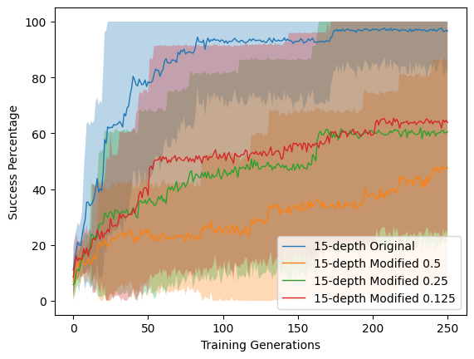
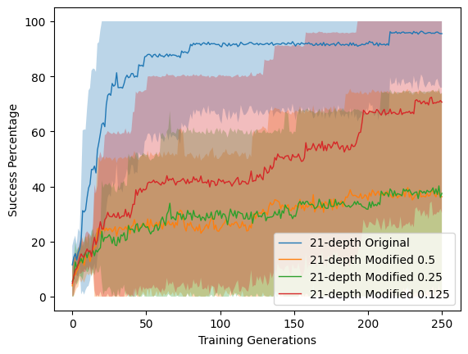
Original vs modified setup
Notes:
TODO: add the new task setup and noise

Slide 14
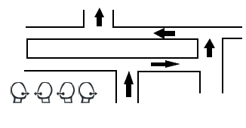

Sequence Recall
Notes:
TODO: Add task setup info

Slide 15
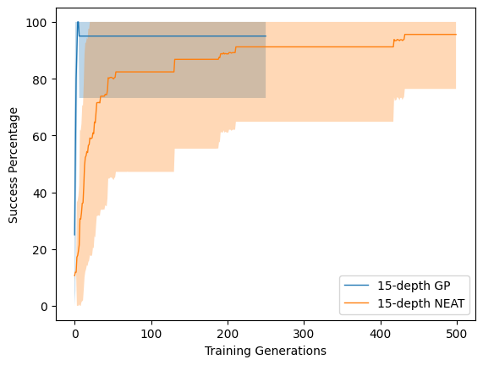
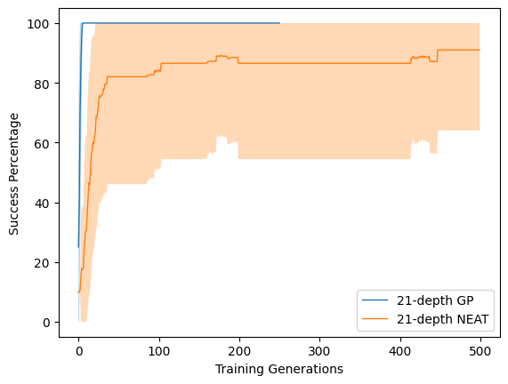
Genetic programming vs neural network

Slide 16
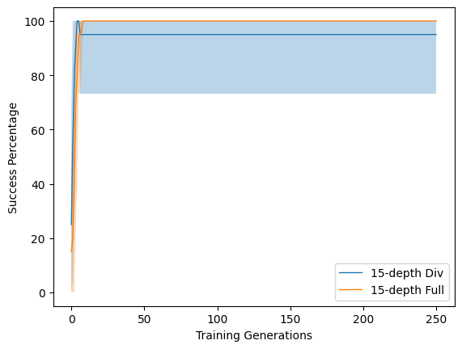
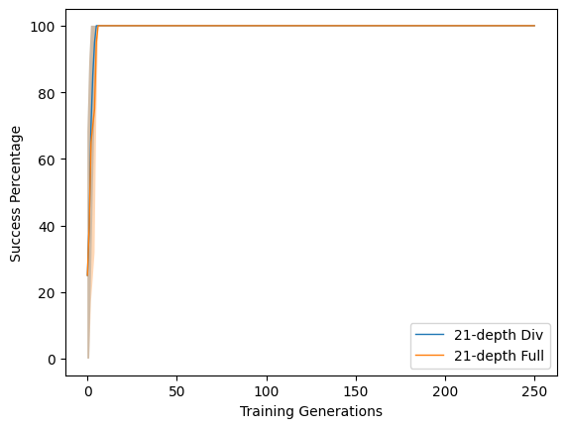
Division vs full instruction set

Slide 17
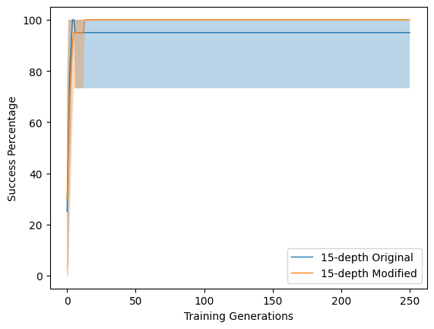
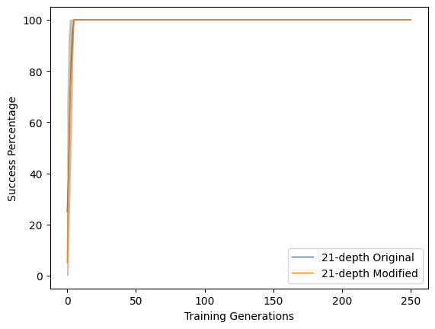
Original vs modified setup
Notes:
TODO: Add how task setup is different

Slide 18
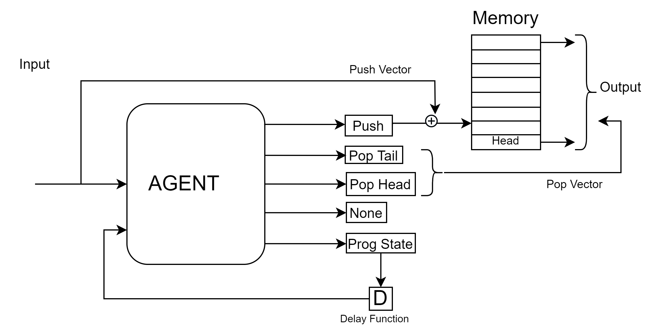
Copy Task Structure

Slide 19
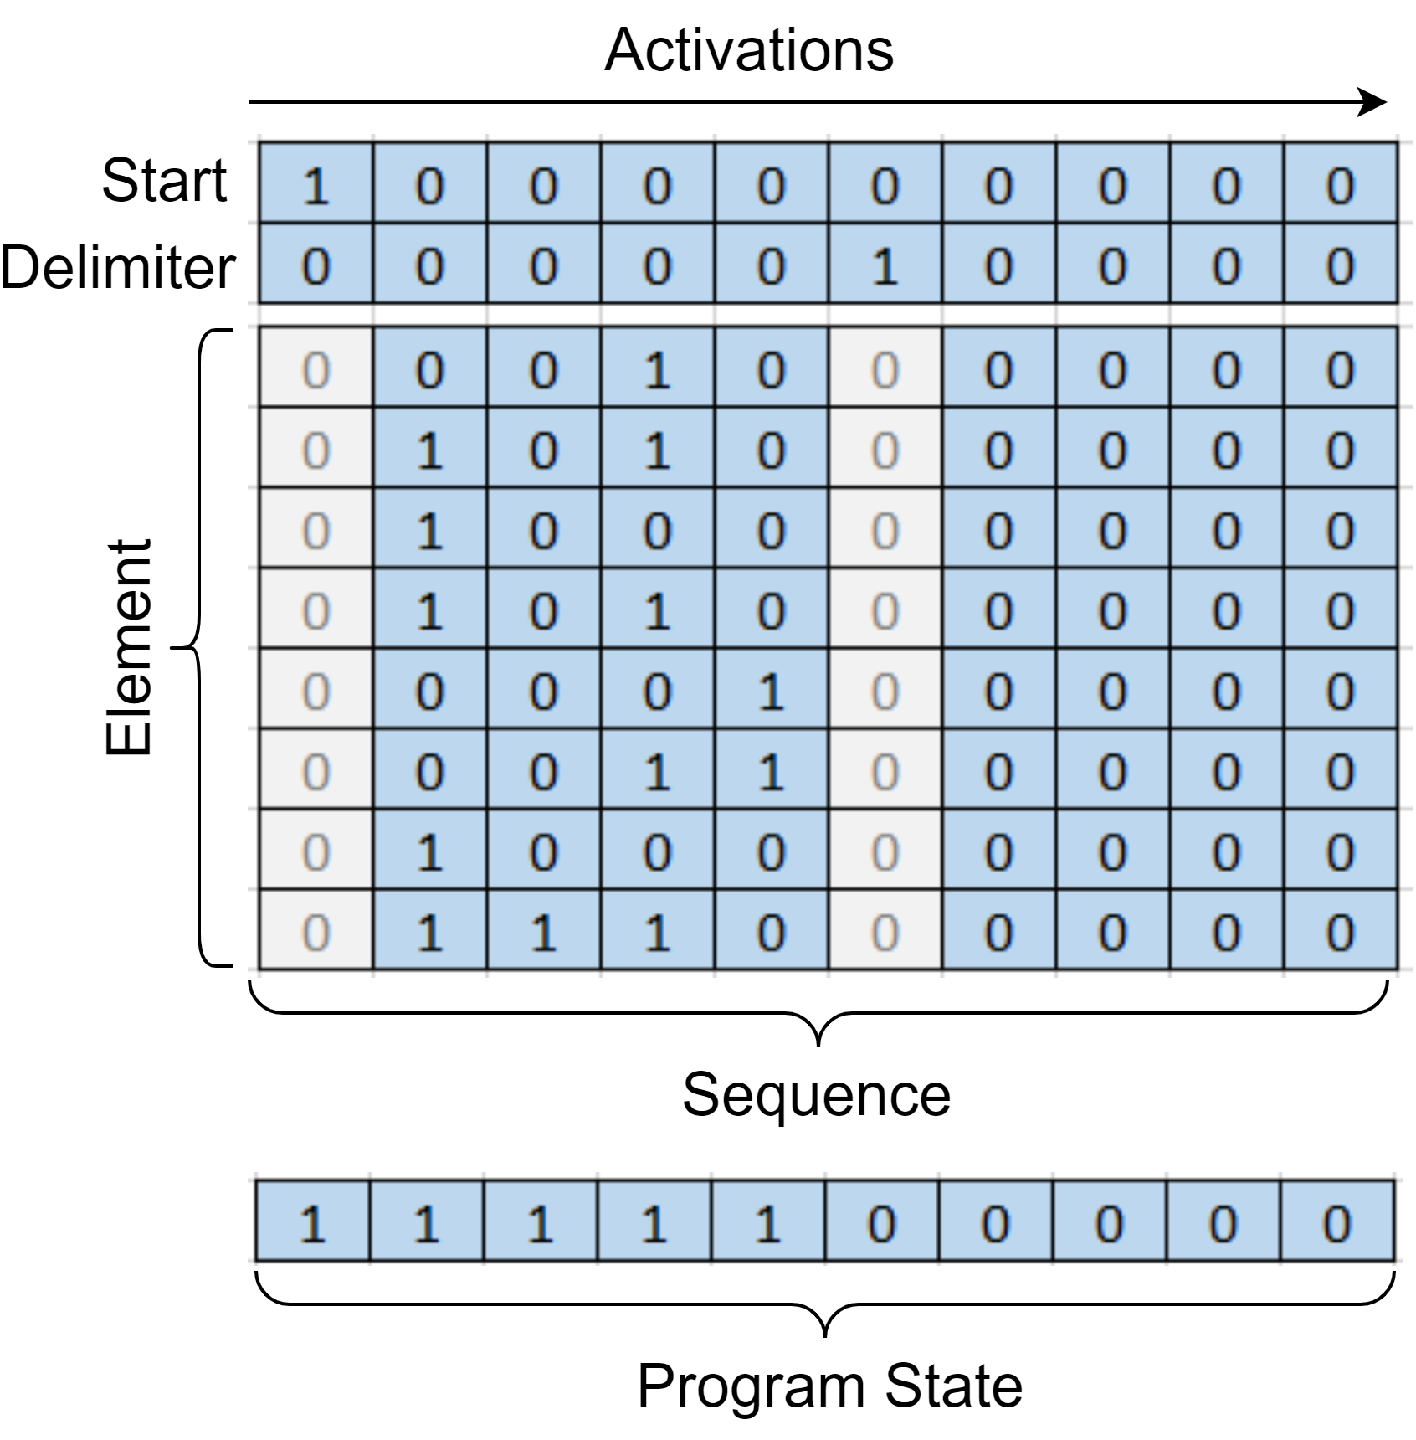
Copy Task setup
Notes:
TODO: Add task setup info

Slide 20
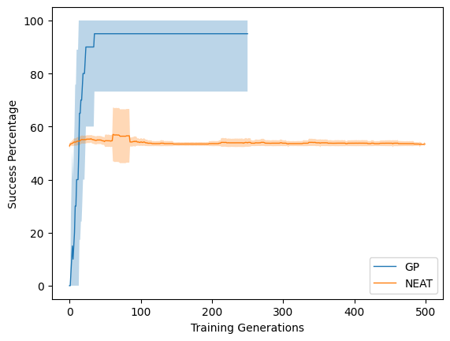
Genetic programming vs neural network

Slide 21
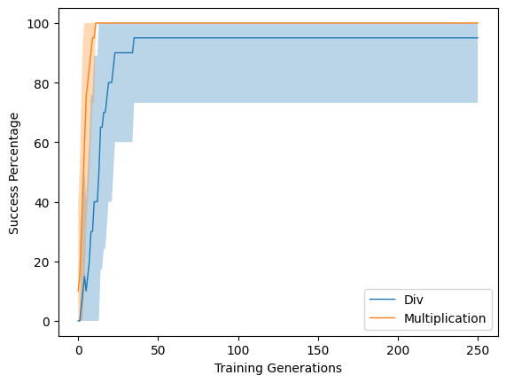
Division vs multiplication instructions

Slide 22
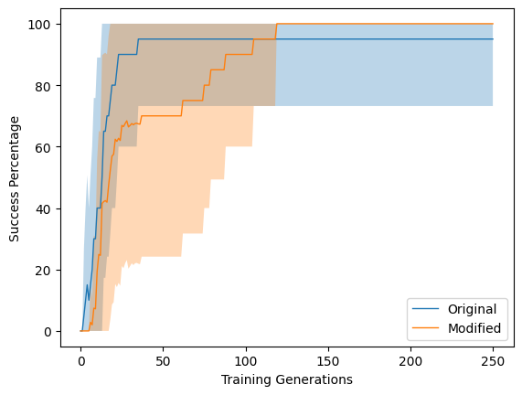
Original vs modified setup
Notes:
TODO: Add info about modified setup

Slide 23
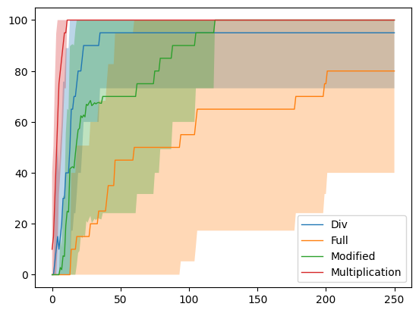
Copy Task all in one

Slide 24
What is next?
Free choices of memory
Q&A

